Slide 1

Data Structures and Algorithms: NP-Completeness
Notes, ICS 340

Slide 2
Decision Problems
Problems here refer to either “decision problems” with Boolean answers or optimization problems recast as decision problems.
Examples:
Is there a TSP tour (Hamiltonian cycle) of a given graph?
Is there a TSP tour of a graph with a distance of less than 50?

Slide 3
Encoding
An initial comment…
The complexity of an algorithm may depend on its encoding.
Arithmetic is slower in unary than in binary.
We will assume a “reasonable” binary encoding for all the problems we discuss.
That is the encoding uses the alphabet ∑ = {0,1}.

Slide 4
Language
A Language over an encoding ∑ is a set of strings within that encoding.
For instance, if ∑ = {0,1} (binary encoding), then the language of all strings ending is 0 is
L = {0, 00, 10, 000, 010, 100, 110, 0000, … }
All solutions to algorithmic problems can (somehow) be expressed as a language.

Slide 5
P
P is the set of decision (“search”) problems for which there are known to be polynomial time solution algorithms.
This is what we’ve been studying all semester.
More formally, let L be a language with alphabet Σ = {0,1}.
P = { L ⊆ {0,1}* : there exists an algorithm A that decides L in polynomial time. }
{0,1}* means bitstrings of size 0 or more.

Slide 6
NP
NP is the set of problems that are verifiable in polynomial time.
NP stands for “nondeterministic polynomial”
If there is a problem Q, and we claim that an instance I of the problem Q has a solution C, then Q is in NP if you can verify in polynomial time that C solves I.
C is called the certificate for instance I of Q.
This is usually pretty easy to see. Most verifications are really quick.
Not all problems are known to be in NP.

Slide 7
NP Example
Suppose that I tell you there is a TSP tour of the following 5 cities of length 3516 miles.
Note that this is a decision problem.
I claim that the tour C→H→K→M→P→C has length 3516. This is the a certificate.
You can easily verify this in polynomial time.
~ Val C H K M P
Cleveland 41.28 ~ 1114 700 630 360
Houston 29.45 1114 ~ 644 1056 1341
KansasCity 39.05 700 644 ~ 413 1039
Minneapolis 44.58 630 1056 413 ~ 985
Philadelphia 39.57 360 1341 1039 985 ~

Slide 8
NP, Formally
The idea is that you have a language L (a problem) and an instance x of that problem. Let y denote a solution to instance x, and A be a verification algorithm.
Then NP is defined as follows: L ∈ NP if L = { x ∈ {0,1}* : there exists a certificate y with |y| = O(|x|^{c}) such that A(x,y) = 1 }
C is a constant here
A(x,y) = 1 means that A verifies that y is a solution to x.
For instance, L could be the spanning tree problem, x could be a specific graph, and y could be a spanning tree of that specific graph.

Slide 9
Co-NP
Co-NP is the class of problems whose complements are in NP.
Example: TSP-Tour ⊆ NP
This means that if you show me how to do a TSP tour, giving me the exact cities in the exact order, I can verify in polynomial time that it works.
!TSP-Tour is then in co-NP, because it’s the complement of TSP-Tour
!TSP-Tour is the problem of verifying in polynomial time that there is no TSP tour for a given set of cities.
This seems intuitively harder than TSP-Tour

Slide 10
P vs NP
So, what’s the relationship between P and NP?
Well, obviously P ⊆ NP, because solving a problem is one way to verify that a solution exists.
But does P = NP? Nobody knows.
But bet against it.

Slide 11
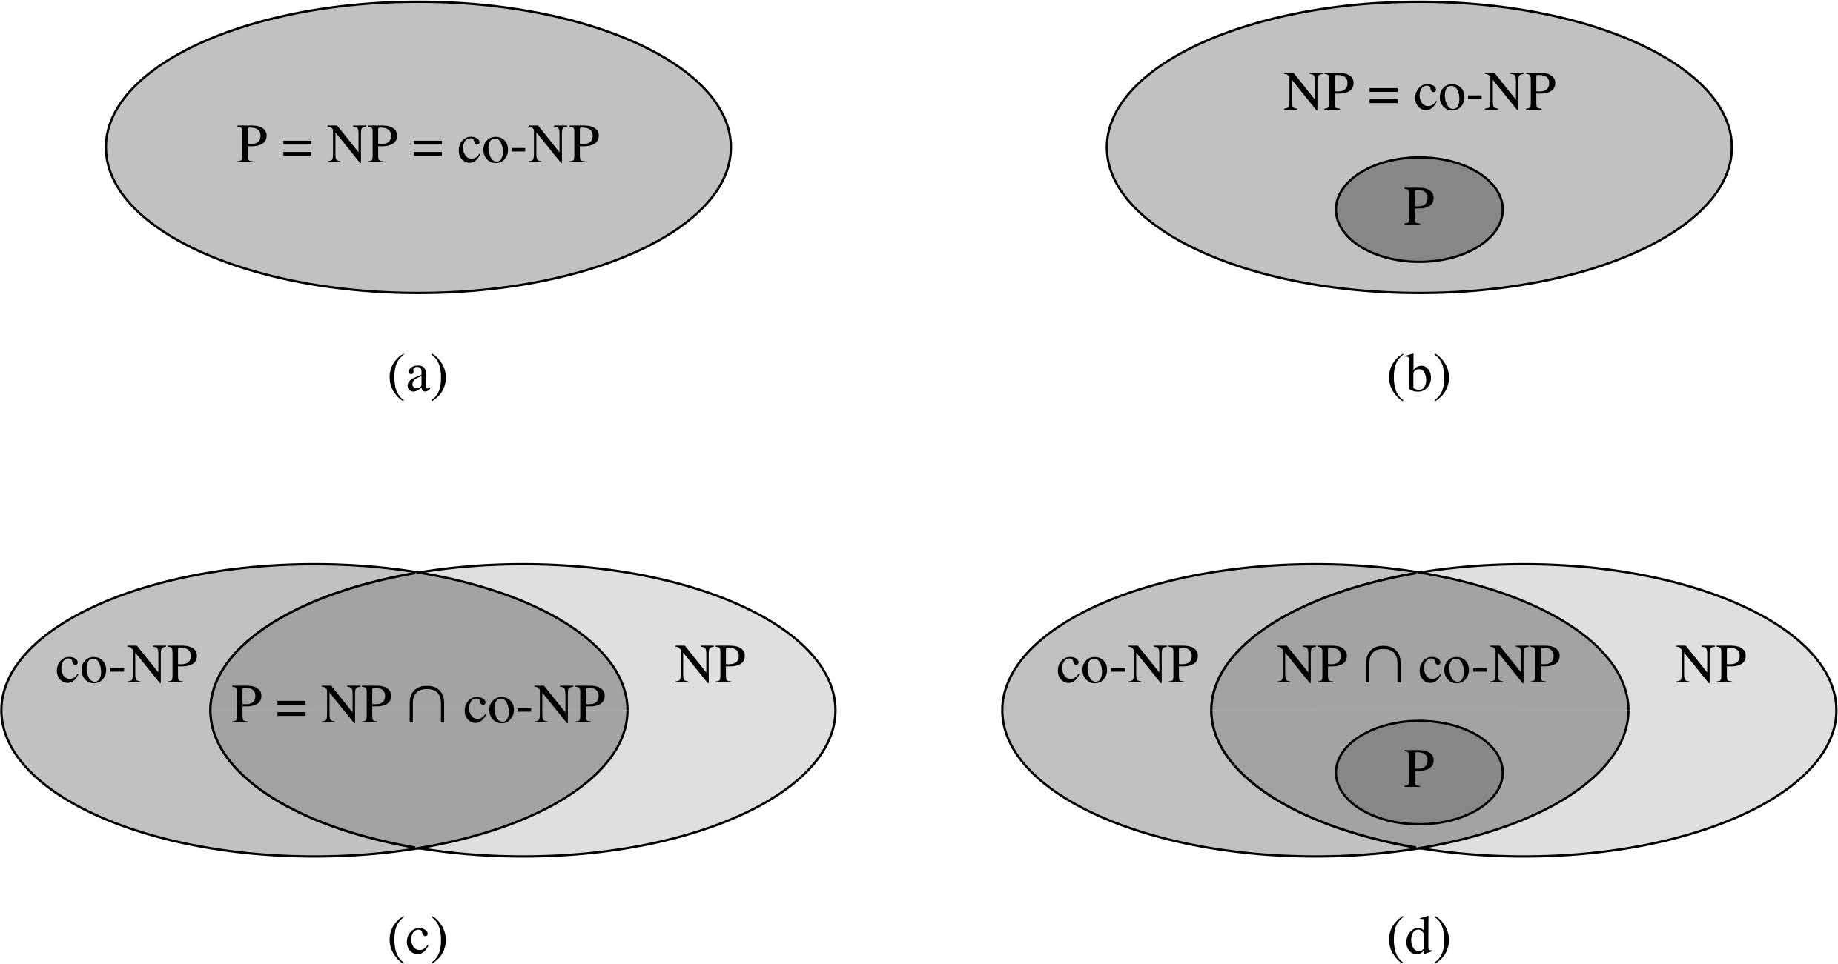
P vs NP - Possibilities
Here are the four possibilities concerning the relationship between P, NP, and co-NP.

Slide 12
NP-Completeness
So nobody knows whether P = NP
However, people have discovered a set of problems called “NP-Complete”, which are the hardest possible problems in NP.
Any NP-complete problem can be converted into any other NP complete problem in polynomial time, and if you found a solution in polynomial time for one, you would have a solution in polynomial time for all of them.
You would also become extremely famous for proving P = NP.
Not all problems in NP, but not known to be in P, are NP-C.

Slide 13
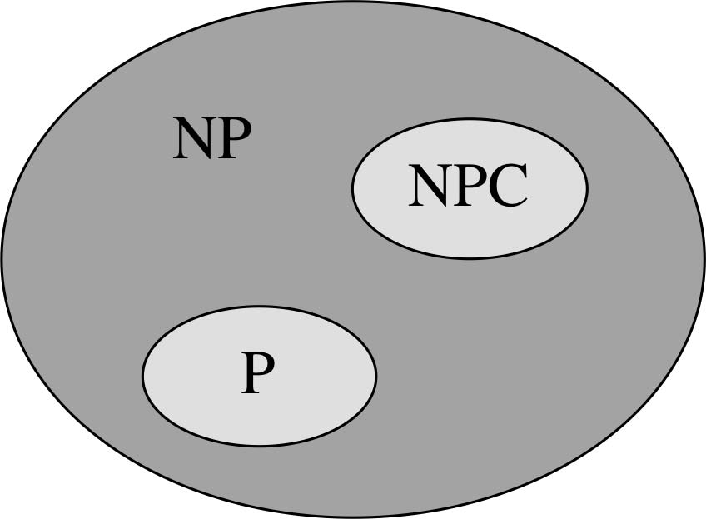
NP-Completeness – we think
Here’s what we think the relationship among P, NP, and NPC is:
Leaving co-NP out of it.

Slide 14
Undecidability
There also exist undecidable problems, which no computer could ever solve in any amount of time.
Halting problem
Last class

Slide 15
Canonical NP-Complete Problem - SAT
We want to find the hardest possible problem in NP.
A problem so hard that if you can solve this problem in polynomial time, you can solve any other problem in NP in polynomial time.
The (Boolean formula) SATisfiability problem is such a problem.
Note: The textbook uses the Circuit Satisfiability problem as the canonical problem.
Since every boolean formula using AND, OR, and NOT can be represented as a boolean circuit with AND, OR, and NOT gates, these are essentially the same problem.
And to do SAT I don’t have to draw pictures!

Slide 16
SAT-II
Consider the Boolean operations AND (∧), OR (∨), and NOT (! or ¬). A Boolean formula is a formula containing Boolean variables and these operators. For instance:
Z = (!x ∨ y) ∧ (x ∨ y)
(Some also use an overbar for NOT. Or a “¬”)

Slide 17
SAT-III
A Boolean formula is satisfiable if there’s a way to make the left-hand variable 1.
In equation Z = (!x ∨ y) ∧ (x ∨ y) x=1 and y=1 gives z=1.
The satisfiability problem SAT is the question of whether it’s possible to assign values to a set of variables to make a Boolean formula satisfiable.
If there are only two variables, this is efficiently solvable.
That is, solvable in polynomial time.
But if there are 3 or more variables it’s NP-Complete.

Slide 18
SAT-IV
SAT is in NP. This is easy to see.
A certificate is an assignment of a value to each boolean variable.
Just run the boolean equation for the circuit with each variable assigned its value and see what the answer is.

Slide 19
Circuit-SAT is NPC
I flip to circuits to follow the proof in the textbook.
But first we have to talk about “reductions”.
Reduction is the technique we will use to prove that problems are NP-Complete.

Slide 20
Theory of Reductions I
A reduction maps a problem into another problem.
For instance, suppose:
I want to solve problem A, and
I have a way to convert (“reduce”) it to problem B in polynomial time, and
I have a polynomial-time solution to problem B, and
I have a way to convert (“reduce”) a solution to problem B into a solution to problem A in polynomial time.
This last step is not necessary for decision problems.

Slide 21
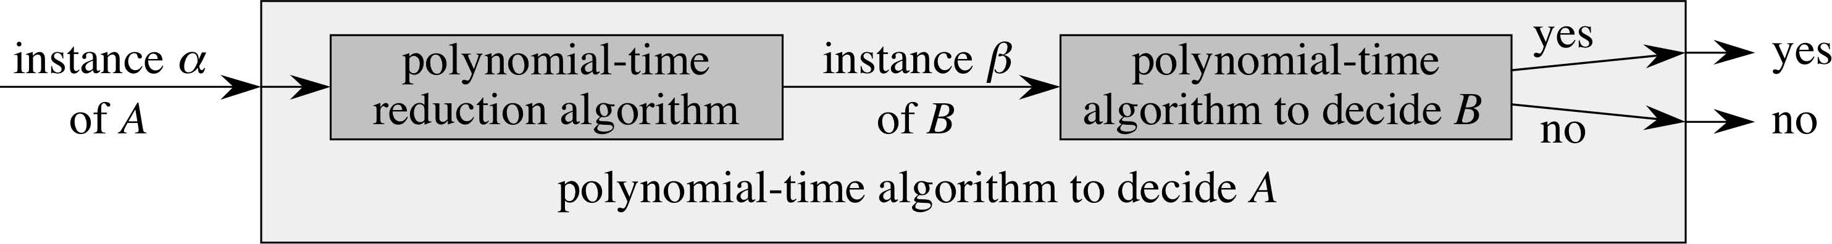
Theory of Reductions II
Here’s what I can do
Convert problem A into problem B
Solve problem B
Map solution to problem B back into solution to problem A
Read off the solution to problem A
Remember, this is a decision problem (has Boolean answer)
If each of these steps is doable in polynomial time, the entire procedure is a polynomial time procedure.

Slide 22
Theory of Reductions III
Our goal is to show that a number of different problems are NP-Complete by reducing them to other problems. But to show NP-Completeness, this is done kind of backwards.

Slide 23
Theory of Reductions IV
To show that problem L? is NPC, given that problem L_{C} is known to be NPC:
Show L? is in NP
Reduce a known NPC problem L_{C} to problem L? in polynomial time
This means that every instance of L_{C} has to be convertible into some instance of L?, but it does not require that every instance of L? be convertible into some instance of L_{C}.
Show that a solution to L? generates a solution to L_{C} in polynomial time.
Show that a solution to L_{C} generates a solution to L? in polynomial time.
Then, if you found a polynomial-time solution to L?, you could use it to get a polynomial-time solution to L_{C}. So L? is at least as hard as L_{C}, so L? is NPC.

Slide 24
Circuit-SAT is NPC (I)
Consider what it means for a program to execute.
A program is stored as a sequence of instructions.
An instruction has an operation and some addresses to operate on.
A program counter keeps track of where the program is.
The entire state of the computation is in memory
If you have enough memory. If not, buy some more!
Call this a configuration of the program.
This memory configuration is modified whenever an instruction is executed.
The hardware that drives these changes is a boolean circuit.

Slide 25
Circuit-SAT is NPC II
Consider a problem in NP (let L be any language in NP, formally)
Then there is an algorithm A that verifies any solution to an instance of L. Suppose A has worst-case running time T(n) = O(n^{k}).
The proof gives a polynomial time reduction algorithm F that computes a reduction f that maps every binary string x to a circuit C=f(x) such that x∈L if and only if C ∈ Circuit-SAT
Choose k big enough so that T(n) = O(n^{k}) and the certificate is also length O(n^{k}).

